Slide 1


Smart Interior Design
Prof. Khaled Wassif
Lecturer, Department of Artificial Intelligence at Cairo University.
Eng. Mohamed Gamal
Teaching Assistant, Department of Information Technology at Egyptian
E-Learning University (EELU) .

Slide 2
Team Members
Name
ID
Andrew Osama Yacoup
20-00665
Mahmoud Abdelwahed Mohmoud
20-00493
Farah Mostafa Nagaty
20-00631
Abeer Anwar Mohamed
20-00462
Elarya samah ageeb
20-00469
Arwa Ahmed Abdelaziz
20-00875
Menna Mamdouh
20-00590

Slide 3
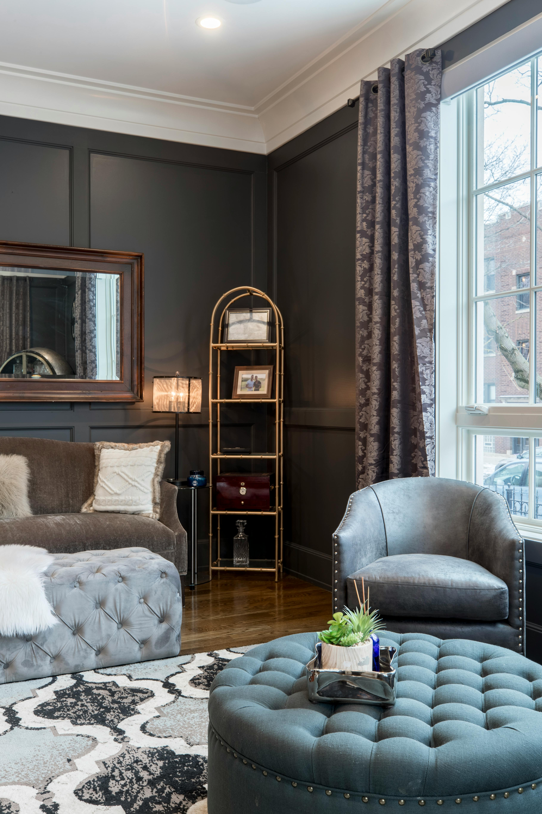
Outlines
The main sections include:
Introduction
Related works
Problem statement
Problem solutions
Software requirements
Used Tools
System Methodology
3D Feature
Back-End
Machine learning
Website Demo
Operations
References

Slide 4

Introduction
This presentation will provide an overview of the exciting potential of AI technology in the field of interior design.

Slide 5
Introduction
Reasons for Project Choice
Lack of Inspiration
Difficulty Visualizing Designs
Many people struggle to find the right design inspiration for their interior spaces.
It can be hard to imagine what a design will look like before it's implemented.
Cost and Time Errors
Rising Costs of Experts
Implementing interior design changes can be costly and time-consuming, especially if mistakes are made.
The increasing prices of interior design professionals can make their services inaccessible for many people.

Slide 6
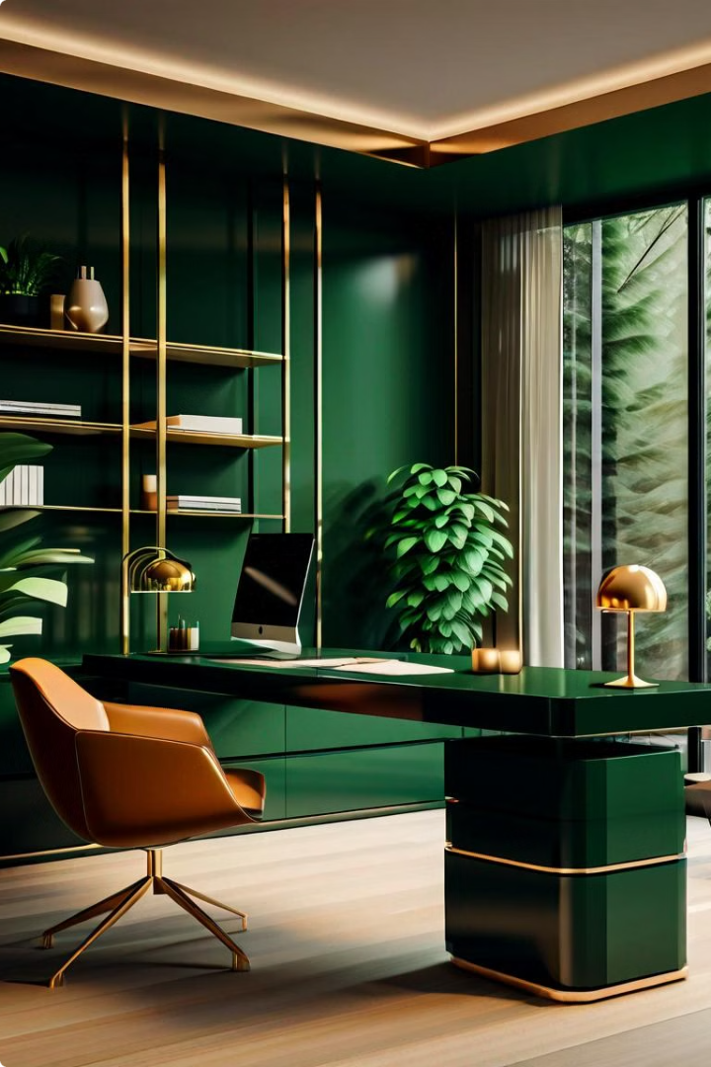
Introduction
AI Revolutionizing Interior Design
AI technology is revolutionizing the interior design industry, bringing efficiency and creativity to the traditional design process.
Our AI Interior Design Website leverages cutting-edge technology to enhance the experience for both designers and homeowners.

Slide 7




Introduction
Revolutionizing Interior Design
Creative Assistance
Inspiration & Visualization
Virtual Reality Experience
Stay Up-to-Date
We keep you informed about the latest interior design trends.
We strive to provide users with AI-powered tools that assist in generating innovative and unique design ideas
Our platform enables users to easily visualize and explore different interior design styles and ideas.
Immerse yourself in virtual spaces to experience the design firsthand before the physical implementation

Slide 8

Related Works
Explore the latest innovations and trends in the world of interior design, where technology and creativity converge to revolutionize the way we envision and transform living spaces.

Slide 9




Related Works
Popular Interior Design Tools
Room Planner: Home Interior 3D
HomeByMe
An interactive 3D room design tool that allows users to create, visualize, and plan their ideal interior spaces.
A comprehensive interior design platform that enables users to design, visualize, and plan their dream homes in 3D.
Houzz Interior-Design Ides
Homestyler – Interior Design
A leading platform for home renovation and design, offering a vast library of inspirational images and design ideas.
An intuitive interior design tool that allows users to create, visualize, and share their custom room designs.

Slide 10
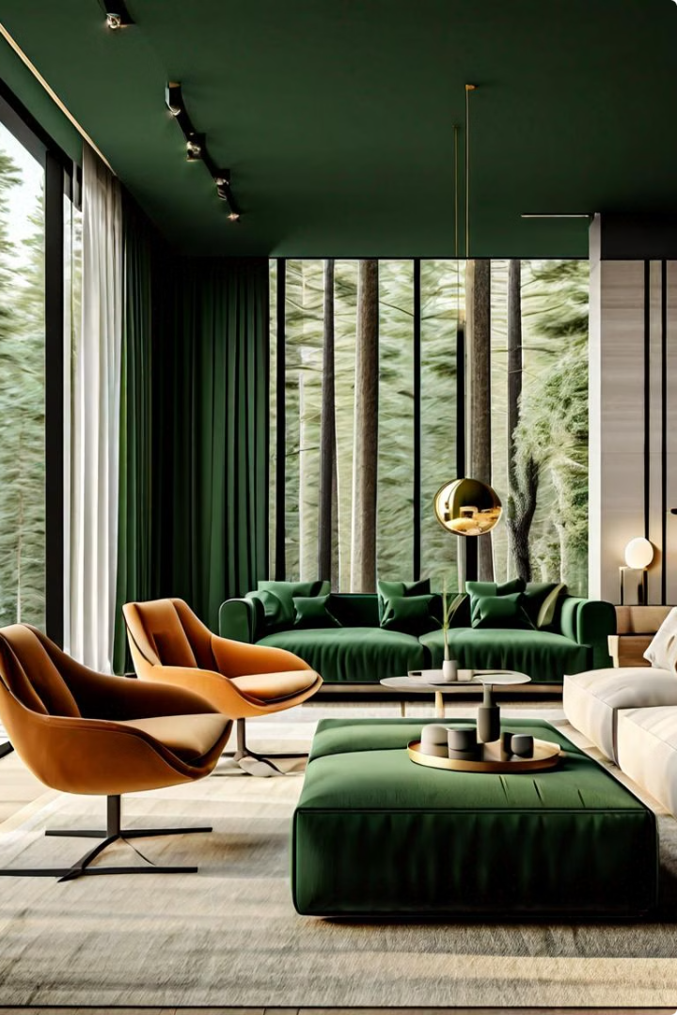
Problem Statement
The key challenge is to identify the core problems that interior design clients face.

Slide 11
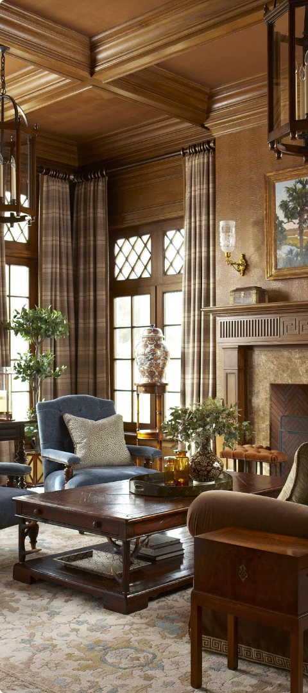
Problem Statement
Challenges in Traditional Interior Design
1
High Time and Effort
2
Costly Mistakes
Traditional design processes can be time-consuming, requiring numerous iterations and adjustments.
Making design changes after implementation can be expensive and inconvenient for homeowners.
3
Limited Visualization
It's challenging for clients to visualize the final design, leading to misunderstandings and dissatisfaction.

Slide 12
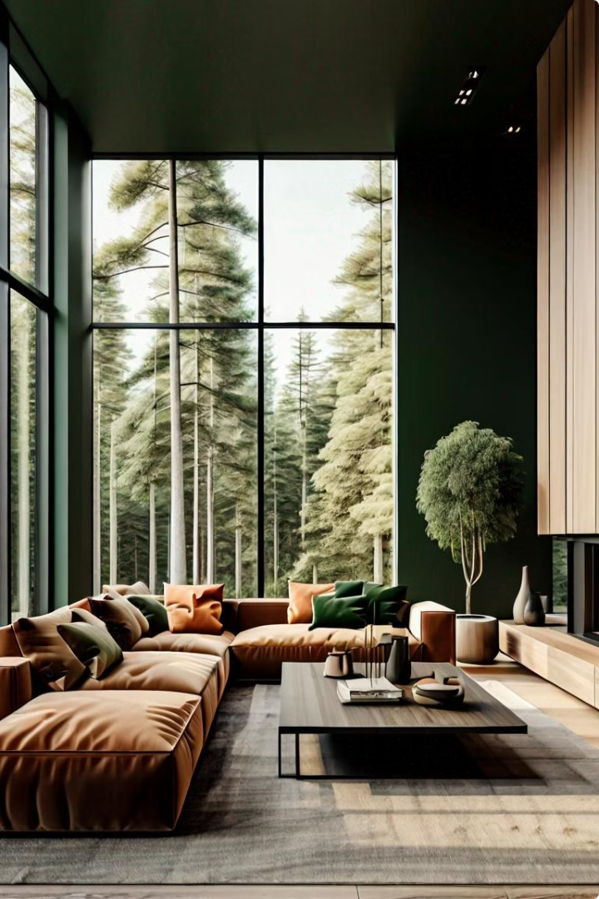
Problem Solution

Slide 13
Problem Solution
Endless Design Catalog
3D Rendering & Virtual Tours
Automated Material Selection
Cost & Resource Optimization
Access a vast library of design inspirations, including various themes, colors, furniture, and arrangements.
Experience your design concepts in realistic 3D renderings and take virtual tours to envision your space.
Minimize errors and save costs by utilizing precise measurements, accurate budget estimations, and resource planning tools.
Let our AI algorithms suggest suitable materials based on your preferences, budget, and project requirements.

Slide 14

Used Tools
ao

Slide 15





Used Tools
VS Code
Colab
Xampp
Figma
Vite

Slide 16

Requirements

Slide 17
Functional Requirements
1
Design with AI
2
Design by 3D Feature
You can photograph your empty room, and by specifying the type of room and style, and through AI, we will give you design suggestions that suit your room.
You can give us the height and width of your room, and through 3D Feature, we can give you the necessary items to create any room and place it in a way that suits your design.
3
Inspiration Templates
Our site provides inspirational templates that suit many designs and through which you can get inspiration for a design that you like.

Slide 18
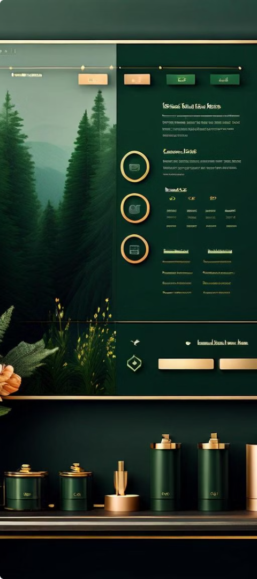
Non-functional Requirements
User-Friendly Interface
Operational
The system shall provide a user-friendly
interface that is intuitive and
easy to navigate.
The web site should run
on all browsers.
Performance
The web site shouldn't take long time while loading and doing any function.
The web site should support large number of visitors.
The web site should be updated and maintained periodically.

Slide 19

System Methodology

Slide 20


WebSite Designs
Logo
Light Mode :
Dark Mode :

Slide 21
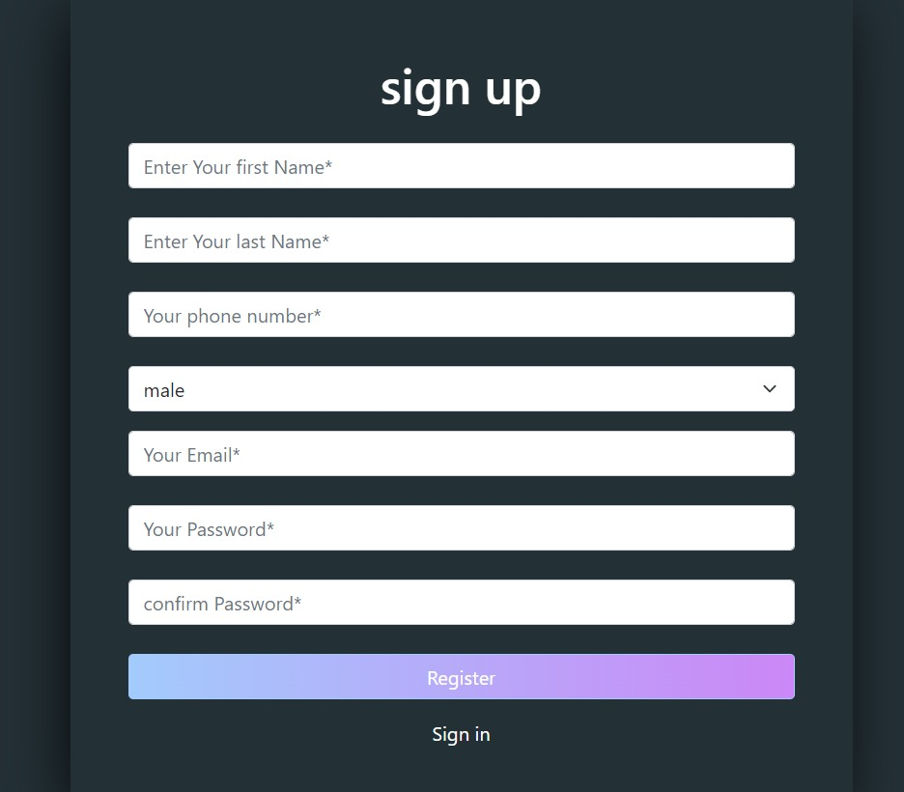
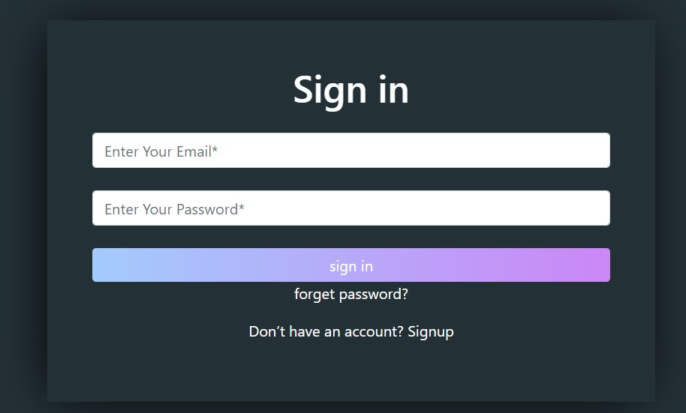
WebSite Designs (Cont..)
Sign up & in page

Slide 22
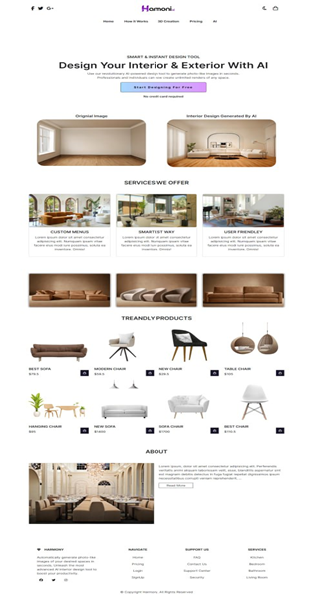
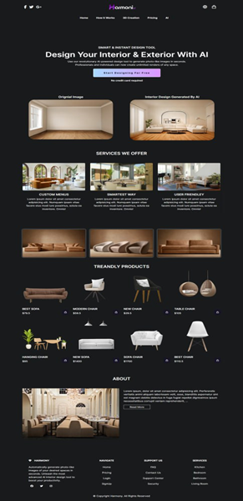
WebSite Designs
Home Page
is the main or introductory webpage of a website. It serves as the entry point to the website, typically displaying essential information and providing navigation options to guide visitors to other sections or pages within the site..

Slide 23
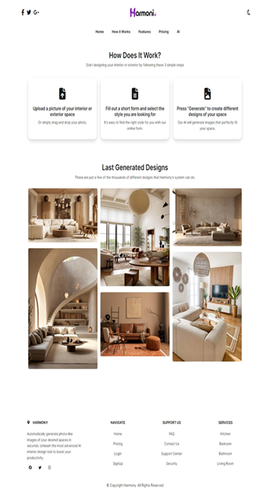
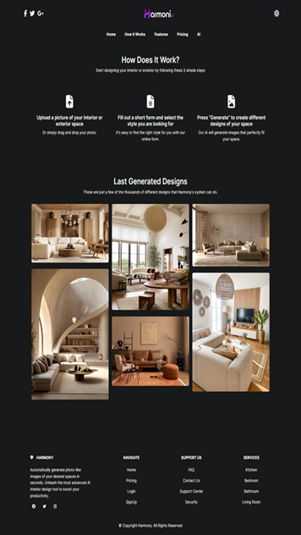
WebSite Designs (Cont..)
How It Work page
is a section of a website that explains the functionality, process, or operation of a product, service, or platform.

Slide 24
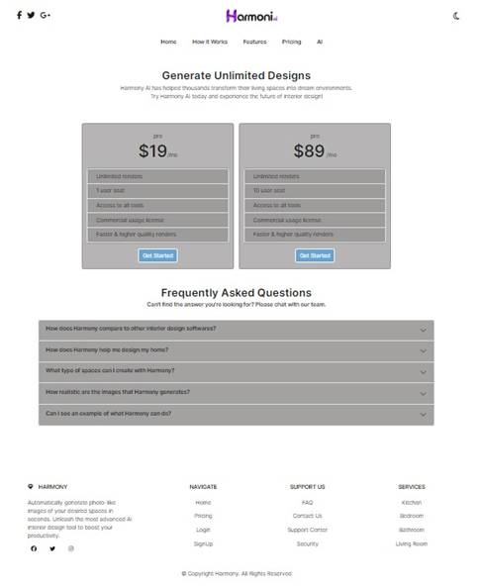
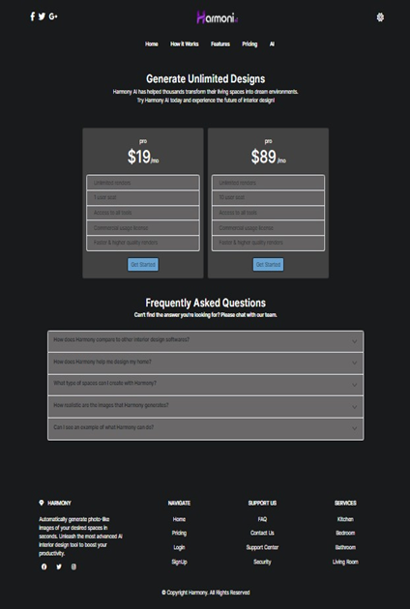
WebSite Designs (Cont..)
Pricing page

Slide 25
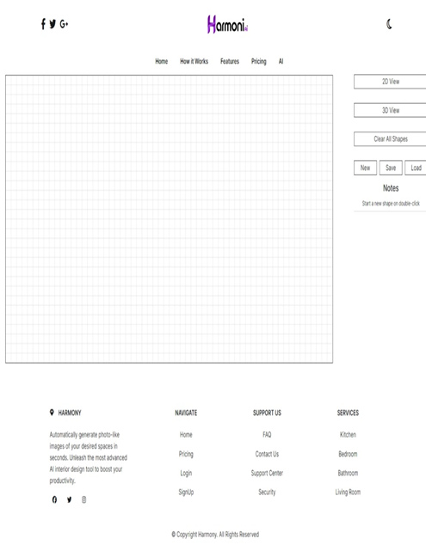
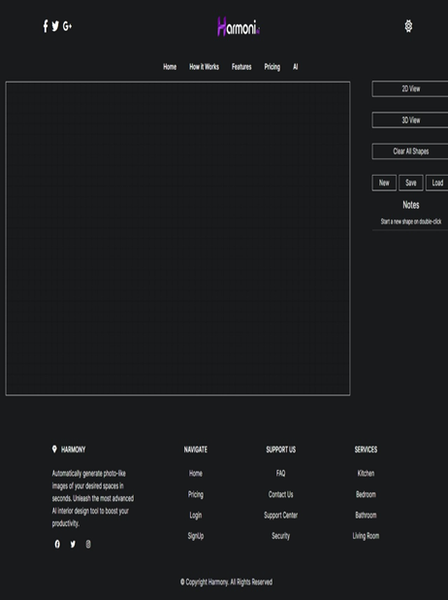
WebSite Designs (Cont..)
3D Page

Slide 26
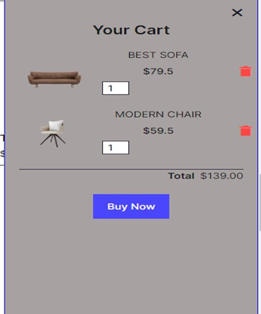
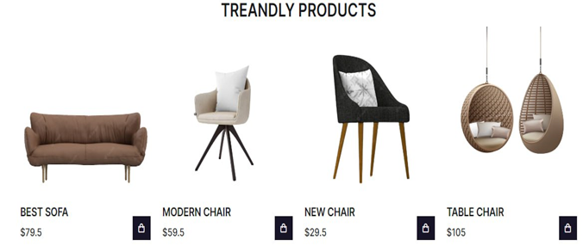
WebSite Designs (Cont..)
Shopping Cart
users can collect and store items they intend to purchase.

Slide 27
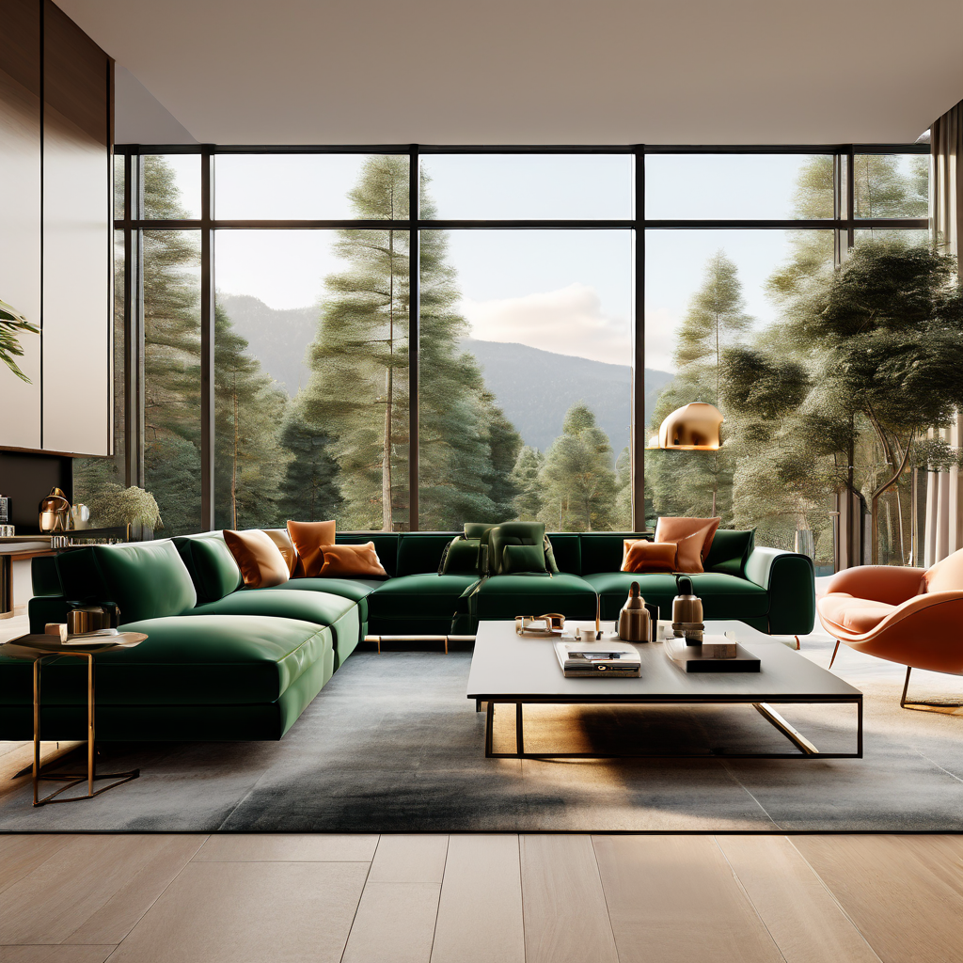
3D Feature

Slide 28

Tools (0/2)

Slide 29
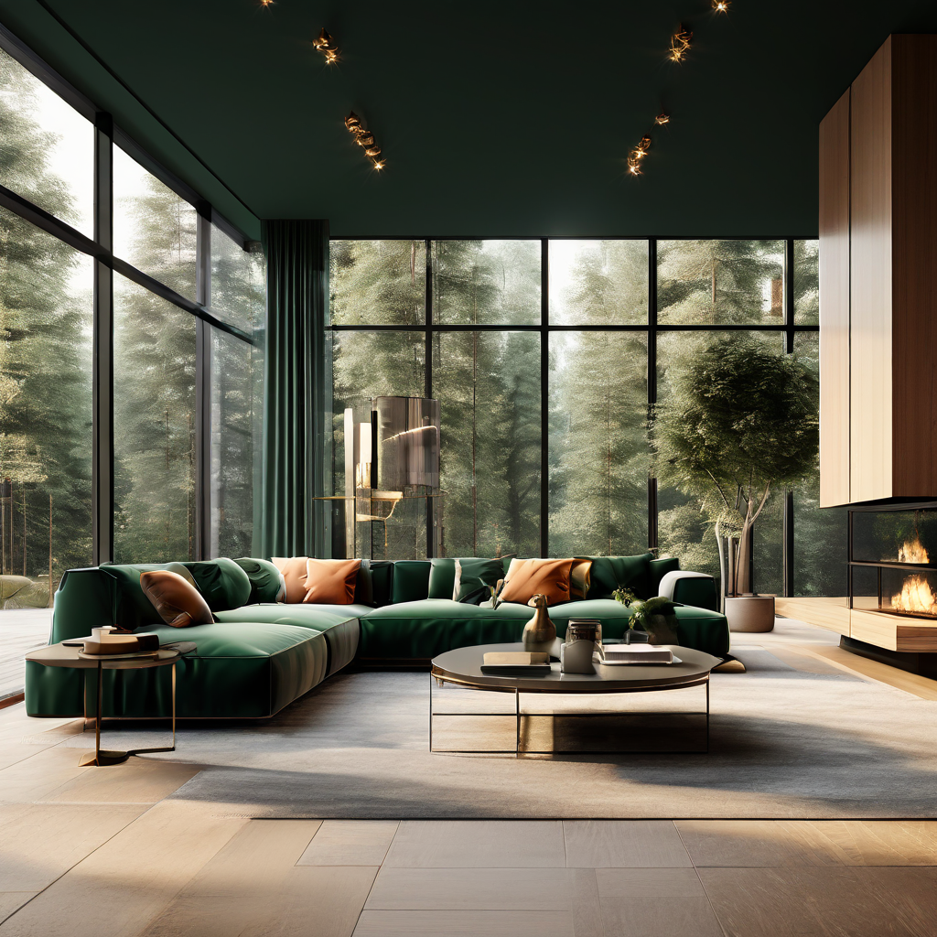
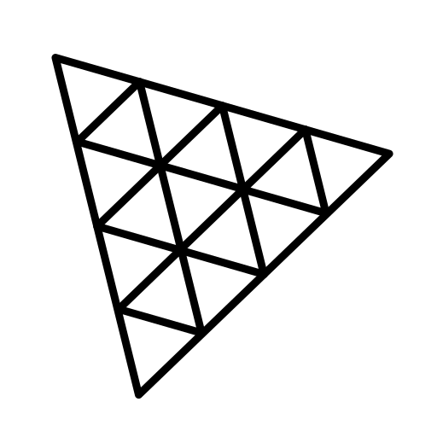
Tools (1/2)
1 - Vite
2- ThreeJS
Why using Vite
We leverage Vite as our front-end build tool to streamline the development of our project (local host).

Slide 30
WebGL vs. Three.js
Why using Three.js?
Choosing Three.js for 3D Web Experiences
Ease Over Complexity: Abstracts WebGL's complexity. Easier for developers.
WebGL vs. Three.js :
WebGL: Low-level API for 3D/2D graphics. Powerful but complex.
Rich Community: Offers extensive resources - examples, plugins.
Three.js: Simplifies WebGL. Offers features like cameras, lights, etc.
Power & Simplicity: Strikes a balance. Ideal for both complex scenes and quick starts.
With Three.js, we leverage a blend of power and ease, supported by a vibrant community. This choice lets us focus on creating immersive 3D web experiences efficiently.

Slide 31
Setting Up a 2D
View Environment (0/4)

Slide 32

Setting Up a 2D View Environment (1/4)
Setting the Grid Size
The gridSpacing variable defines the spacing between grid lines. In this example, the spacing is set to 20 pixels.
The drawGrid Function: This function draws vertical and horizontal lines across the canvas to form a grid.
Vertical lines are drawn across the canvas width, and horizontal lines are drawn across the canvas height.

Slide 33
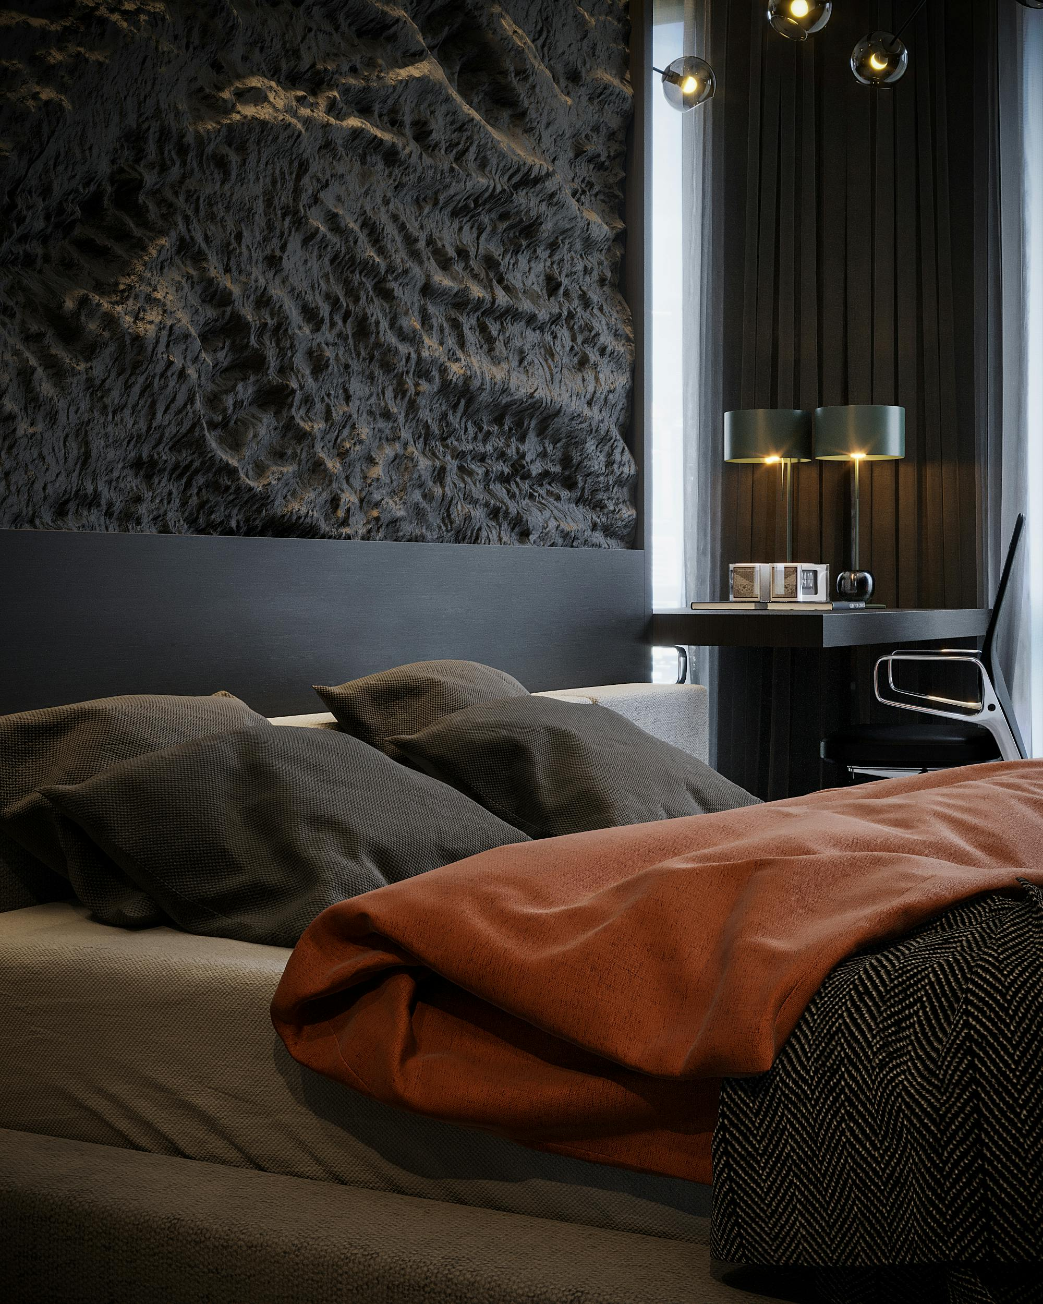
Setting Up a 2D view Environment (2/4)
1
Shapes [ [ ] ] (shapes [ shape[] , shape[],shape[] .. ])
The Shapes Array is an empty array that will hold the points for each shape. Each shape is represented as a list of points, Each point has an 'x' and 'y' coordinate.
Shapes[ [( x1 , y1 ) , (x2 , y2 ) (x3 , y3 ) , (x4 , y4 )] , [(x1 , y1 ) , (x2 , y2 ) ] ]
2
Add Points
You can add a new point to the end of the current shape in the Shapes Array, specifying its 'x' and 'y' coordinates.
3
Draw Lines
To draw the shapes, we go through each shape in the Shapes Array and draw lines between its points. If a shape has only one point, we skip it, as you need at least two points to make a line. We pick a color for the lines and start at the first point, drawing lines to each subsequent point. We also draw a small circle at each point to make them visible.

Slide 34

Setting Up a 2D view Environment (3/4)
Canvas Update
We draw a line from the last point to where the mouse is to show where the next point will go and show a small circle at the mouse to preview the next point. (hover line and point effect)
When click on Clear all shapes button We clear the canvas and draw everything again: the grid, shapes, lines, and points.
How It Reacts:
Mouse Move: The canvas updates showing a line and point following the mouse.
Mouse Click: Puts a new point where you click.
Double Click: Starts a new shape by making a new list for it.

Slide 35
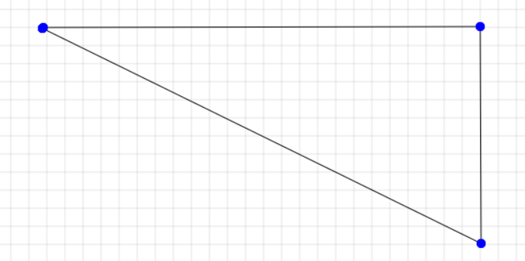
Setting Up a 2D View Environment (4/4)
How to Use 2D View Environment
Making Shapes: Click to add points. Lines connect these points into shapes, shown as circles.
Keep Adding: Click more to add points to your shape.
New Shape: Double-click to start a new shape. It doesn't stop the previous one; it just begins collecting points for another shape.

Slide 36
Setting Up a 3D
View Environment (0/4)

Slide 37




Setting Up a 3D view Environment (1/4)
Creating a 3D Scene with Three.js:
1. Scene Setup
Initializes the 3D scene by creating a new THREE.Scene instance.
2. Camera Setup
Configures the perspective camera using a THREE.PerspectiveCamera.
Camera Comparison:
Perspective Camera
Orthographic Camera
Mimics how the human eye perceives the world where objects farther from the camera appear smaller than those close to it.
Maintain the size of objects regardless of their distance from the camera.

Slide 38



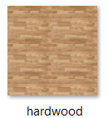

Setting Up a 3D view Environment (2/4)
Renderer Setup
3
Initializes the WebGL renderer with THREE.WebGLRenderer, activating sRGB encoding for accurate color representation.
Adding Lights
4
Adds ambient and directional lighting mimicking environmental light and sunlight using THREE.AmbientLight and THREE.DirectionalLight.
Adding the Floor
5
Uses THREE.TextureLoader to create a textured floor.
Controls and Raycaster Setup
6
Implements OrbitControls to allow users to rotate, zoom in and zoom out around the scene.

Slide 39
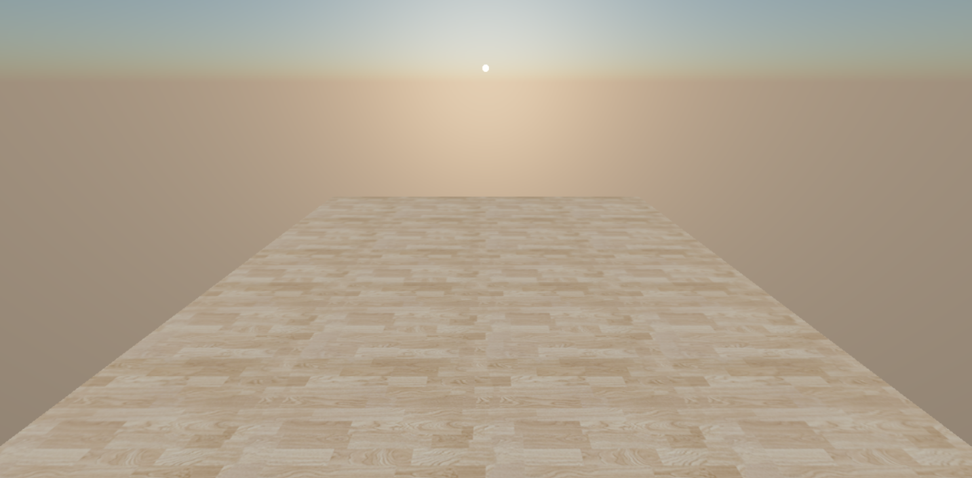
Setting Up a 3D view Environment (3/4)
SkyShader Function
Adding sky shader by adding Lights, sky object, sun object and putting his position.

Slide 40
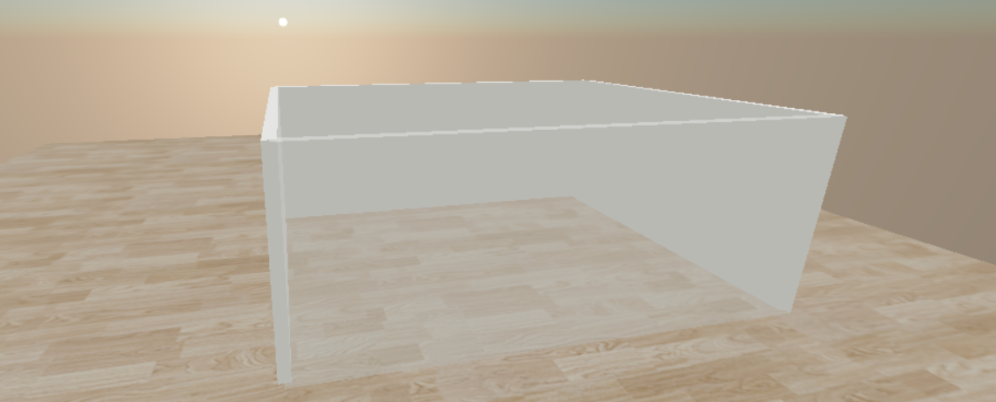
Setting Up a 3D view Environment (4/4)
Interaction and Animation
Animate Function: Acts as the animation loop, continuously rendering the scene and updating elements based on user interaction or other dynamic factors.
Adjusting Shapes' Opacity
Utilizes a raycaster to adjust the opacity of selected objects, If an intersection is found, the intersected object's material opacity is reduced, making it semi-transparent.
We reduce the transparency of the wall opposite the camera so that we can see what is inside.

Slide 41
Integration between
2D view in 3D view(0/2)

Slide 42
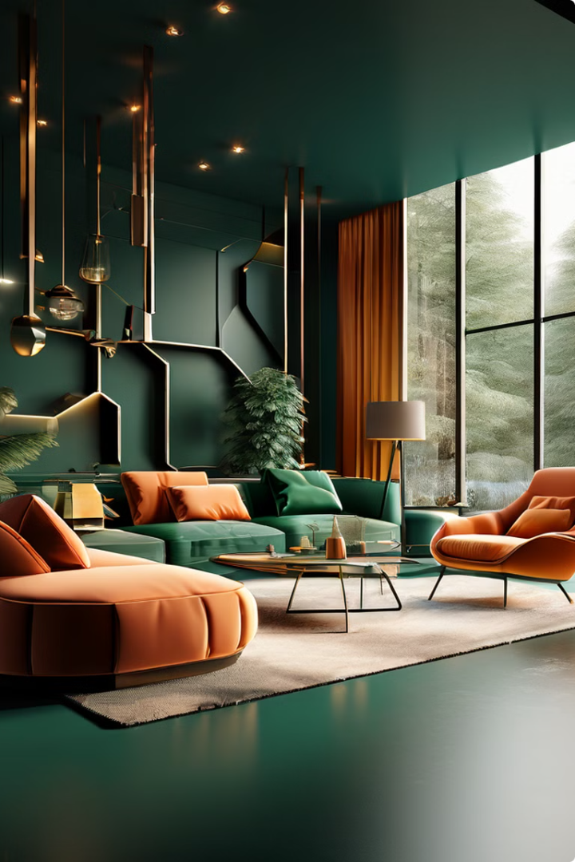
Integration between 2D view in 3D view (1/2)
Add and update walls in a 3D scene Using Three.js
Process Overview
Initial Setup: Define wall parameters such as height and thickness to establish the basic physical characteristics of the walls.
Create Walls: The function iterates over the shapes array, processing each shape contained within. For each shape, it iterates through pairs of points to create individual walls. Each pair of points serves as the (start) and end (end) points of a wall.
Calculate Wall Length and Angle: It calculates the distance (length) and angle between the start and end points. These calculations are used to determine the length and orientation of the wall.

Slide 43




Integration between 2D view in 3D view (2/2)
Dynamic Update with update 3DView Function:
Clearing Old Walls
Start by removing any existing walls to prepare for new updates. This is achieved by clearing the oneShape group from the scene.
Constructing Walls
Through iteration, construct walls based on coordinates within the shapes array. Use THREE.BoxGeometry to create the walls, applying THREE.MeshPhongMaterial for realistic lighting effects. Position and rotate each wall before adding wall to the oneShape group.
Adjusting Group Position
Once all walls are added, adjust the entire group's position and rotation as needed for correct scene alignment.
Scene Update
Employ the animate function to render the updated scene, reflecting the newly added walls.

Slide 44
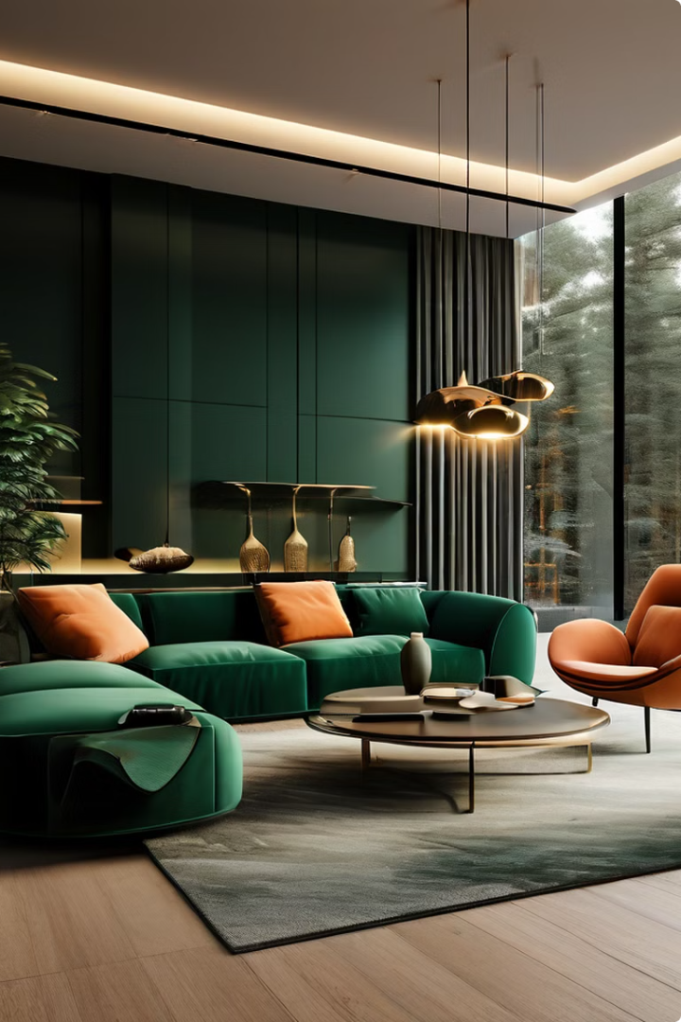
3D Furniture Interaction and Controls (0/4)

Slide 45
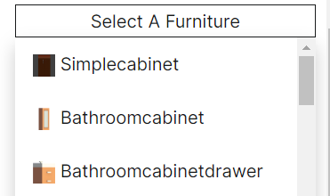
3D Furniture Interaction and Controls (1/4)
Furniture Selection Interface
Loading 3D Models
The interface utilizes jQuery to create a dynamic dropdown menu for furniture selection.
Each menu item is linked to a 3D model of furniture, allowing users to choose from a diverse library of 142 .glb furniture model files.
The 3D models are loaded asynchronously using GLTFLoader.
A THREE.Group instance is created for each model, simplifying the manipulation of furniture objects as single entities.
The models also feature enhanced realism through shadow casting and receiving for all model parts.

Slide 46
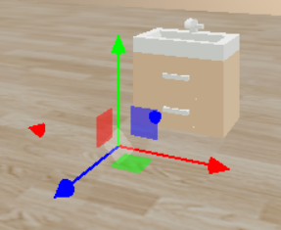
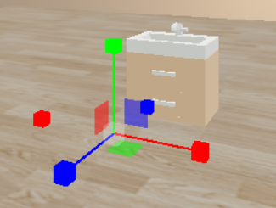
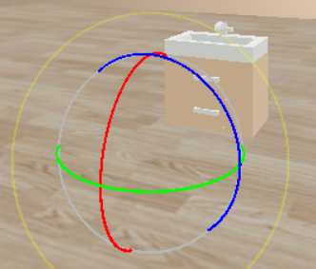
3D Furniture Interaction and Controls (2/4)
Interactive Model Manipulation
1
TransformControls
Translate
TransformControls are applied to each furniture model, enabling intuitive translate, rotate, and scale interactions.
2
Efficient Management
The system maintains an array of TransformControls instances for efficient management, allowing for the enable and disable of these controls.
Scaling
3
Advanced Controls
Keyboard inputs further refine user control, offering modes for translation, rotation, and scaling.
Rotate

Slide 47
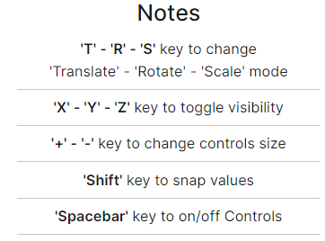
3D Furniture Interaction and Controls (3/4)
Enhancing User Experience
Visibility Toggles
Size Adjustments
The system offers visibility toggles for object axes, allowing users to customize the display for better visibility.
Users can change the size of Transform Controls to suit their preferences and enhance the overall user experience.
Snap Values
Enable/Disable Toggle
Snap values are available for precise alignment, enabling users to achieve accurate furniture placement.
The system includes an enable/disable toggle for Transform Controls, further improving the user experience.

Slide 48
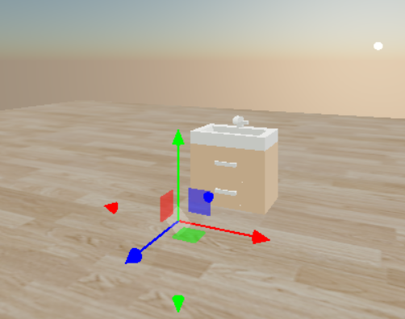
3D Furniture Interaction and Controls (4/4)
Drag-and-Drop Functionality
Draggable Objects
Group Dragging
Orbit Controls
The implementation includes a dragControlsList array for managing draggable objects within the scene.
The system handles group dragging, ensuring a smooth interaction process for users.
Orbit controls are also implemented, allowing for an intuitive and user-friendly interface during the drag-and-drop process.

Slide 49
2D and 3D View Buttons (0/2)

Slide 50
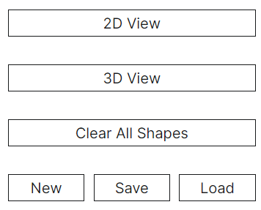
2D and 3D View Buttons (1/2)
2D View Buttons
1
Toggle Between 2D & 3D Views
2
Clear All Shapes (2D) & Furniture (3D)
Adjust the visibility of related buttons to allow users to switch between 2D and 3D views.
Provide a way for users to clear the 2D canvas and remove 3D furniture objects.

Slide 51
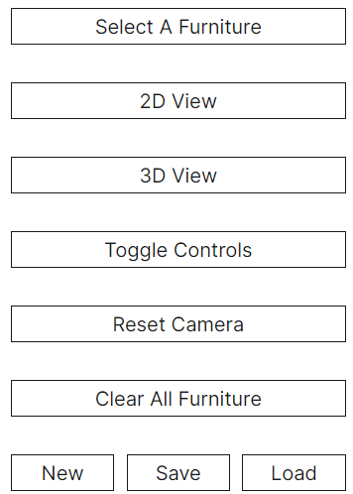
2D and 3D View Buttons (2/2)
3D View Buttons
1
Toggle Controls Button
2
Reset Camera Button
Implement a button to toggle the visibility and state of TransformControls.
Allow users to reset the camera to its initial position and rotation.
3
New One Button
4
Save Functionality
Provide a comprehensive reset option that clears both 2D and 3D views, and resets the camera.
Allow users to serialize the 3D scene and 2D shapes to JSON for download and later use.
5
Load Functionality
Implement the ability to parse selected JSON files to restore the 3D scene and 2D shapes.

Slide 52

Back-End
The backend refers to the server-side components of a web application, responsible for handling the core functionality and data processing. This includes the server, databases, APIs, and other behind-the-scenes systems that power the user-facing frontend.

Slide 53
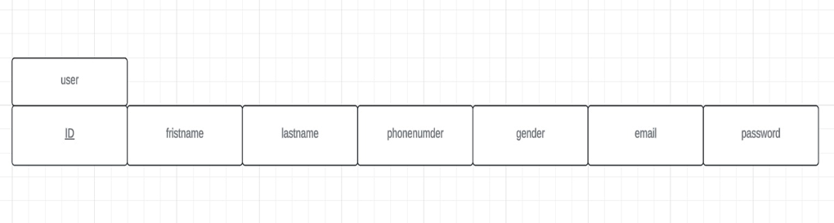
Set Up the Database
1
Create the database
2
ER Schema
To set up the database, the first step is to create the database itself. Once the database is created, the next step is to define the ER (Entity Relationship) schema, which outlines the structure and relationships between the various entities in the database.

Slide 54
The Sign Up System
Enter Personal Information
Click "Register": The user clicks the "Register" button to send their information to the website.
Account Creation and Confirmation
Verification and Sign-in

Slide 55
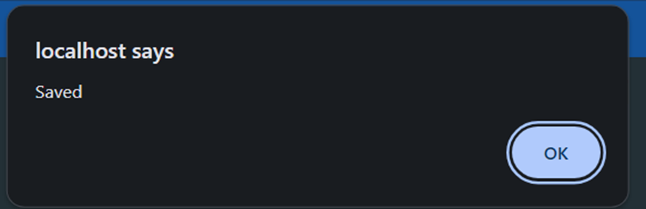
The Sign Up System
5. Save to Database
The user will enter their data, which will then be saved to the database.
Go to Sign-in page …

Slide 56
The Sign-in System
After signing up go to sign in page .
Enter your Email.
Enter your Password.
Click "Sign in ": The user clicks the "Sign in" button to send their information to the database to check it.
Successful Sign-in: If the email and password match the records, you are taken to your Home page.
Unsuccessful Sign-in: If there’s a mistake, you see an error message telling you the email or password is incorrect, and you can try again or reset your password if needed.

Slide 57
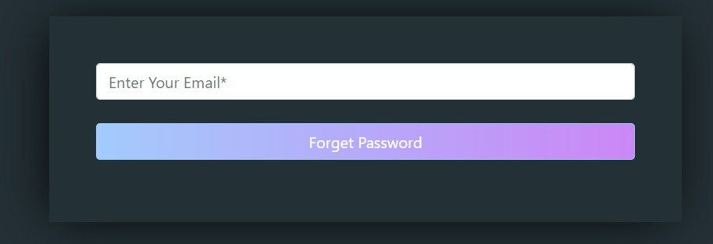
Forget Password
On the sign-in page, the user finds and clicks the "Forgot Password" link, usually located near the sign fields.

Slide 58
Forget password
1
Handle Form Submission
When a user forgets their password, they will submit a form with their email address. This form submission needs to be properly handled to initiate the password reset process.
2
Load Composer's Autoloader
To use the PHPMailer library, the Composer autoloader needs to be loaded to make
the necessary classes and functions available.
3
Download PHPMailer
The PHPMailer library is used to send the password reset email to the user.
It needs to be downloaded and integrated into the project.
4
Generate Forget Password
When the user forgets their password, a unique token needs to be generated
to allow them to reset their password securely.
5
Check if Email Exists
Before generating a reset token, the system needs to check if the email
provided by the user exists in the database.

Slide 59
Forget password (cont…)
6
Generate a Secure Token
A secure token needs to be generated, which will be used to verify the user's identity
during the password reset process.
7
Token Expiry Time
The generated token should have an expiration time, after which it will become invalid
to ensure the security of the password reset process.
8
Save Token and Expiry in Database
The generated token and its expiration time need to be saved in the database,
associated with the user's email address.
9
Send Email Using PHPMailer
Once the token is generated and saved, an email needs to be sent to
the user's email address using the PHPMailer library, providing instructions on
how to reset their password.
10
Recipients
The password reset email should be sent to the email address provided by the user
during the forget password form submission.

Slide 60
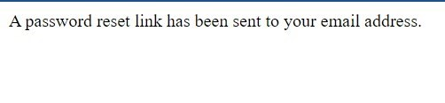
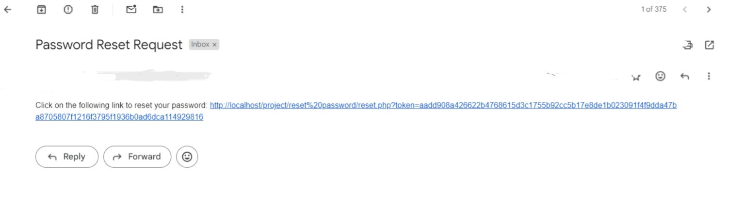
Forget Password Action
After the user writes the correct mail and clicks forget password,
this is the message:
The user checks the email for a password reset email to arrive in their inbox. This email is sent by the website's system and typically contains a link to reset the password. The user opens the password reset web page.

Slide 61
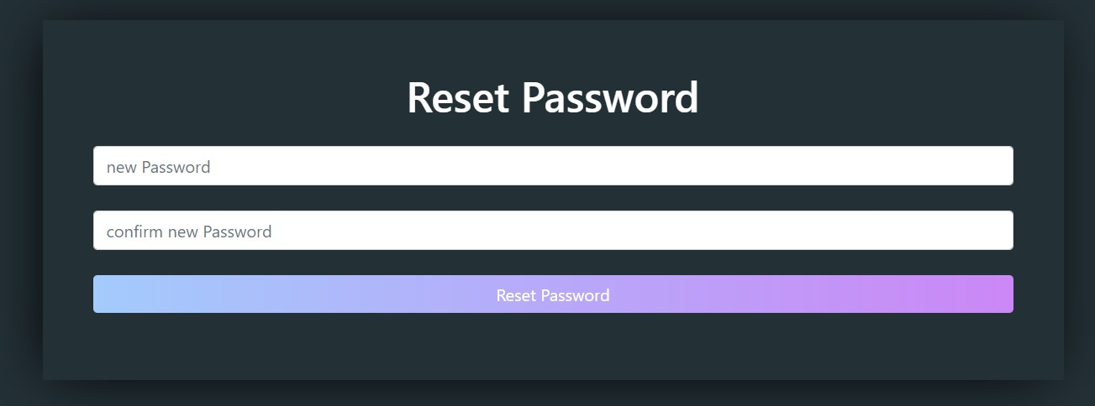
Reset Password
The user enters a new password into a field labelled "New Password".
The user re-enters the new password into a field labelled "Confirm New Password“ to match the new password.
Click "Reset Password“.

Slide 62




Reset Password
Generate a Password Reset Token
When a user requests to reset their password, generate a unique token that can be used to verify their identity and allow them to set a new password.
Send Password Reset Email
Send the user an email with a link that includes the password reset token. This allows them to access the password reset form and update their password.
Handle Password Reset Form Submission
When the user submits the password reset form, verify the token and update the user's password in the database.
Update the User's Password
Once the token is verified, securely update the user's password in the database. This ensures the user can now log in with their new password.

Slide 63
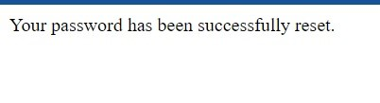
Reset Password Action
The user sees a message on the website confirming that their password has been successfully reset.
After this message, the user can go back to the sign-in page.

Slide 64

Introduction to AI Image Generation
AI-powered image generation has transformed the creative landscape, enabling the rapid production of visually stunning and imaginative artworks. This presentation will explore the Stable Diffusion model, a powerful deep learning system that can generate high-quality images from textual descriptions.

Slide 65
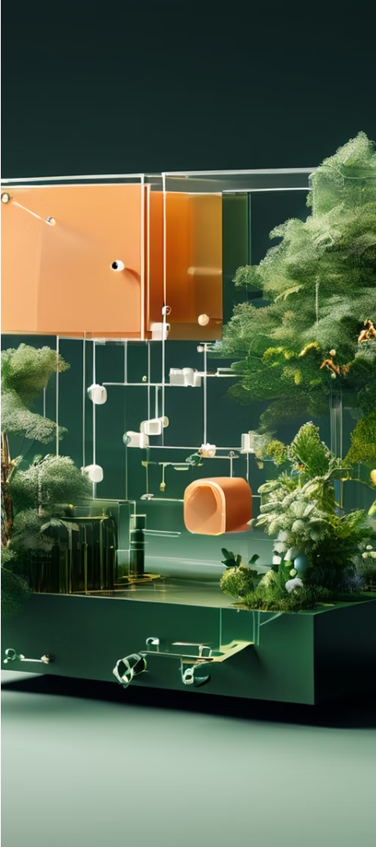
Overview of Diffusion Models
Definition :
Diffusion models are a type of generative model that use the process of diffusion to generate realistic samples from a given distribution, such as images , from random noise.
They work by gradually transforming noise through a series of steps using neural networks. Each step refines the noise, making it more detailed and closer to the desired output.
By repeating this process many times, diffusion models can produce high-quality samples that resemble the real data they were trained on.
These models have shown great potential in various applications
Use Case of our model :
This solution provides endless inspiration for interior design enthusiasts. Whether you're a stylist looking for new ideas or someone wanting to refresh your living space, this tool is perfect for you, it generates interior designs tailored to your room. Simply upload a photo of your space or type a prompt and let the program work its magic.

Slide 66
Diffusion Models Components
Diffusion models specially stable Diffusion model is built on a powerful encoder-decoder architecture, comprising three key components:
Image Encoder: This component is responsible for converting input images into a compact, latent representation that can be used by the diffusion model.
Text Encoder: This component encodes textual descriptions into a latent representation that can be used to guide the image generation process.
Diffusion-based Image Generator: This is the core component of the Stable Diffusion model, which uses a diffusion process to generate new images from the latent representations provided by the encoder components.
By leveraging these three interconnected components, the Stable Diffusion model is able to generate high-quality, visually stunning images from textual descriptions, enabling a wide range of creative applications.

Slide 67
Techniques Used
Data Augmentation :
Techniques such as rotation, scaling, and cropping used to increase the diversity of the training dataset. Helps in improving model generalization and performance
DreamBooth tuning :
is a technique to teach new concepts to Stable Diffusion using a specialized form of fine-tuning we fine-tuned stable Diffusion V2.1-768px
ControlNet :
our app relies on ControlNet, which is a neural network structure to control diffusion models ( In this case our model )
Enhances the precision and flexibility of interior design generation by incorporating user-defined constraints and control signals.

Slide 68
Libraries/Frameworks Used
TensorFlow :
Provides a flexible platform for implementing machine learning algorithms efficiently.
PyTorch :
Used for model training and experimentation.
Offers dynamic computational graphs which are beneficial for developing and testing the model.
Wget :
Utilized for downloading data and resources needed for training and testing the model.
huggingface_hub :
Provides access to trainable models and datasets, facilitating easier model development and deployment.
Cchardet :
A library for detecting character encodings, useful for processing text data efficiently and accurately.

Slide 69

Training process
-Dataset Preparation:
We gathered Initial dataset: of 5,000 images across 5 classes
(Bedroom, Living room, Bathroom, Dining room, Kitchen) ,By using Wget library : For downloading dataset resources .
-Data Augmentation:
We started with a dataset of 5 after data augmentation it expanded into 10,000 images to Improve model generalization and performance
-Base Model Selection: getting Stable Diffusion V2.1-768px by using huggingface_hub library: To access and download the model
-DreamBooth Fine-Tuning:
• Class-specific training on augmented dataset
• Adjusting model weights to recognize interior design styles
• Iterative fine-tuning with performance monitoring

Slide 70
Training process
-ControlNet Integration:
• Incorporating user-defined constraints
• Training ControlNet layers alongside main model
-Hyperparameter Optimization:
adjust
• Learning rate: How quickly the model learns
• Batch size: Amount of data processed at once
• Number of training epochs
-Model Validation:
Cross-validation on held-out dataset
Real-world testing with diverse interior design scenarios
-Model Deployment:
Preparing the model for production using huggingface_hub or webUi

Slide 71
Computational Requirements
Hardware Requirements:
- High-performance GPUs (e.g., NVIDIA A100 or equivalent)
- Minimum 4 GB GPU memory
- 8 GB+ system RAM
- Multi-core CPU (16+ cores recommended)
- Fast SSD storage for dataset and model checkpoints
- Software Environment:
- CUDA-enabled environment for GPU acceleration
- Python 3.7+
- PyTorch and TensorFlow frameworks
- Docker for containerization (optional but recommended)
-Inference (Generation) Phase:
- Real-time generation requires at least 8GB GPU memory
- CPU inference possible but significantly slower
- Optimized for batch processing of multiple requests

Slide 72
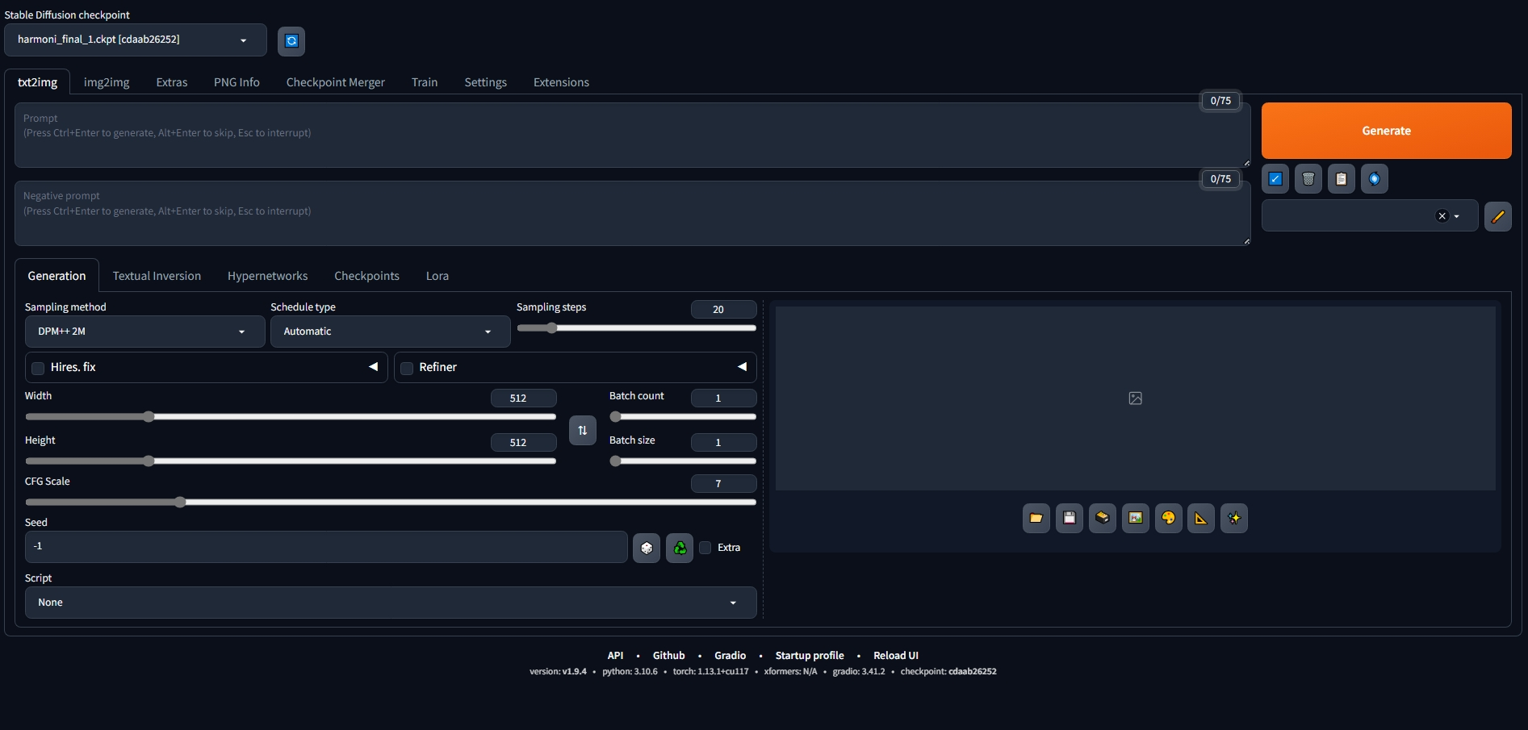
Stable Diffusion Interface Guide

Slide 73
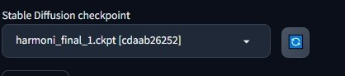
How to use AI page
Top Section Overview
Stable Diffusion Checkpoint
This dropdown allows you to select the model checkpoint you want to use for image generation. The selected checkpoint is harmoni_final_1.ckpt.

Slide 74
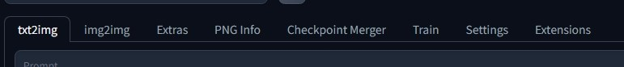
How to use AI page )Cont…)
Main Tabs Overview
1
txt2img
2
img2img
This tab is for generating images from textual descriptions (prompts).
This tab is used for generating images from other images by modifying the input image based on a textual description.
3
Extras
PNG Info
4
Provides additional functionalities and settings for advanced usage.
Displays metadata and other information about generated images.

Slide 75
How to use AI page )Cont…)
Main Tabs Overview (Cont…)
5
Checkpoint Merger
6
Train
Allows you to merge different model checkpoints to create a new model with combined features.
Provides options for training and fine-tuning models on new data.
7
Settings
Extensions
8
General settings for configuring the interface and underlying model.
Options to add or manage extensions that enhance the functionality of the interface.

Slide 76
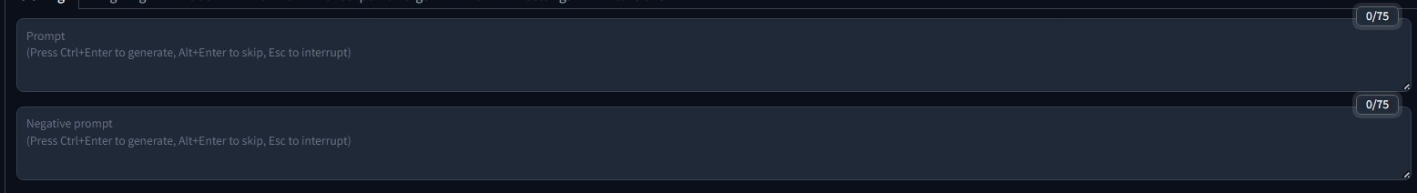
How to use AI page )Cont…)
Prompt Area
Prompt
Negative Prompt
The text box where you enter the description of the image you want to generate. You can press Ctrl+Enter to generate an image, Alt+Enter to skip, or Esc to interrupt.
Text box for specifying aspects you want to avoid in the generated image.

Slide 77

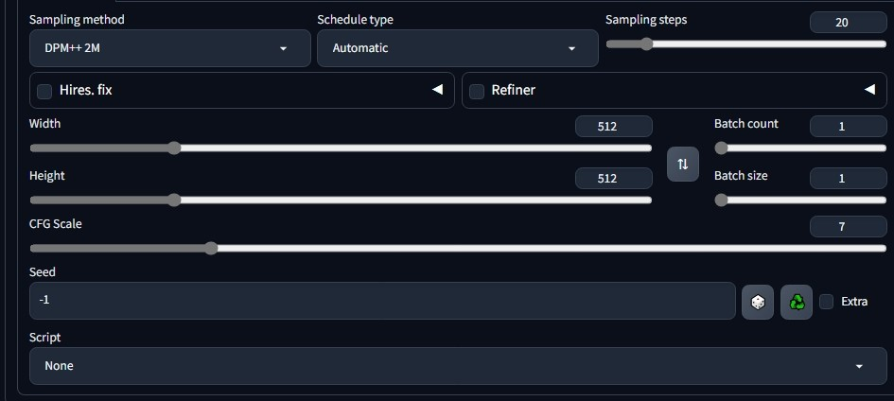



How to use AI page )Cont…)
Additional Generation Settings
Sampling Method
Dropdown to select the sampling method. Here, DPM++ 2M is selected, which is a specific algorithm used during the image generation process.
Schedule Type
Controls the schedule of the sampling process. It’s set to Automatic.
Sampling Steps
Slider to adjust the number of steps the model takes to generate an image. More steps can lead to higher quality but take more time. Set to 20 in this case.
Hires, Fix
Checkbox and associated settings for enabling high-resolution
image generation.

Slide 78
How to use AI page )Cont…)
Additional Generation Settings (Cont…)
CFG Scale
Slider to adjust the guidance scale, which controls how much the image generation process follows the prompt. Higher values can make the image adhere more closely to the prompt. Set to 7 in this case.
Seed
Numeric input to set the random seed for image generation. Using the same seed with the same prompt will produce the same image. Set to -1, which typically means a random seed is used.
Batch Settings
Batch count is set to 1, which means how many sets of images to generate. Batch size is set to 1, indicating the number of images to generate per set.

Slide 79
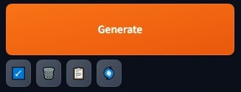
How to use AI page )Cont…)
Bottom Controls
Generate Button
Control Icons
The orange button that starts the image generation process based on the provided prompt and settings.
Icons for loading, saving, copying, and other operations related to generated images.

Slide 80

Model Output

Slide 81

Model Output
A) Text to Image

Slide 82

Model Output (Cont…)
A) Text to Image (Cont…)

Slide 83

Model Output (Cont…)
A) Text to Image (Cont…)

Slide 84

Model Output (Cont…)
A) Text to Image (Cont…)

Slide 85

Model Output (Cont…)
A) Text to Image (Cont…)

Slide 86

Model Output (Cout…)
A) Image to Image

Slide 87

Model Output (Cout…)
A) Image to Image (Cont…)

Slide 88

Model Output (Cout…)
A) Image to Image (Cont…)

Slide 89
Model Output (Cout…)
A) Image to Image (Cont…)

Slide 90

Model Output (Cout…)
A) Image to Image (Cont…)

Slide 91

Model Output (Cout…)
A) Image to Image (Cont…)

Slide 92

Website Demo
The Website video is a crucial component of the presentation, This video will showcase the key features and capabilities of the system, highlighting its seamless integration and intuitive interface.

Slide 93

Operations
Explore the key operations and functionality of our comprehensive website. Streamline your workflows and unlock new possibilities.

Slide 94
Operations
All missions in our the website:
(Complete)
1. Design logo
2. Design:
(Complete)
Home Page
(Complete)
How It Work Page
(Complete)
Pricing page
(Complete)
3D page
(Complete)
Design With AI
(Complete)
3. Initial train in small dataset

Slide 95
Operations (cont…)
All missions in our the website:
(Complete)
4. 3D Feature environment
(Complete)
5. Final train in large dataset.
6.Connection between website
And Mahine Learning.
(Complete)

Slide 96
References
A list of sources and materials that we consulted in our project.

Slide 97




References
https://www.roomgpt.io/
https://www.coohom.com/
https://www.zmo.ai/interior-ai/
https://aihomedesign.com/
This website offers a variety of AI-powered tools for interior design, including a room planner, a style guide, and a virtual reality experience.
This website provides a platform for users to create and share their interior design ideas, as well as access a library of 3D models and textures.
This website offers an AI-powered interior design service that can generate personalized design plans based on user preferences.
This website provides a variety of AI-powered tools for interior design, including a room planner, a style guide, and a virtual reality experience.

Slide 98

Thank You
We appreciate your time and attention,
Please let us know if you have any other questions.

